Slide 1
Rock paper Scissors Convolutional Neural Network
Michael Shepherd

Slide 2



Introduction
Question: Would using a pre-built hand detection model such as Google’s MediaPipe improve the efficiency and/or accuracy of a Rock-Paper-Scissors CNN in real-world applications?

Slide 3
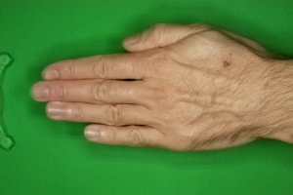
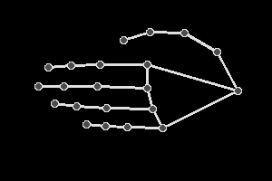
Data Selection/Feature extraction
Original dataset found at https://www.kaggle.com/datasets/drgfreeman/rockpaperscissors and modified using MediaPipe
MediaPipe used to detect hands in images and extract the locations of joints and hand segments, then output a simplified hand shape before training or prediction

Slide 4
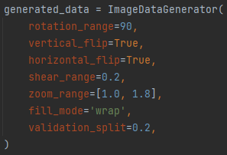
Methods (data augmentation)
Model created using Keras/Tensorflow
Features extracted using MediaPipe prior to training/prediction
Keras ImageDataGenerator used to:
Augment input data via rotation, shear, zoom, and vertical/horizontal flip to increase model flexibility and decrease likelihood of overfitting
Hold out 20% of data for validation before training begins

Slide 5
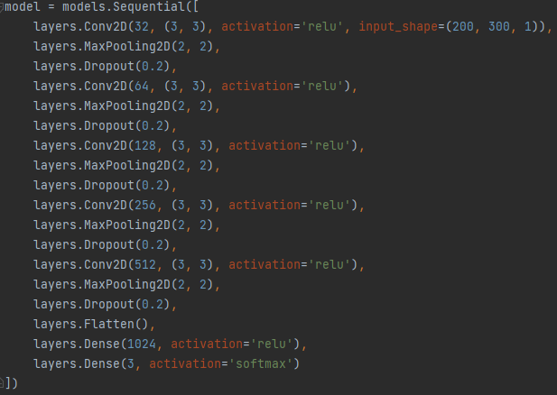
Methods (Model training)
Convolutional neural network uses multiple sets of 2D convolution and max pooling layers to exaggerate and recognize features within images
20% dropouts between each layer help prevent overfitting and further improve flexibility at the cost of training time
Output layer consists of “softmax” activation function and 3 neurons to correspond to the 3 categories being classified

Slide 6

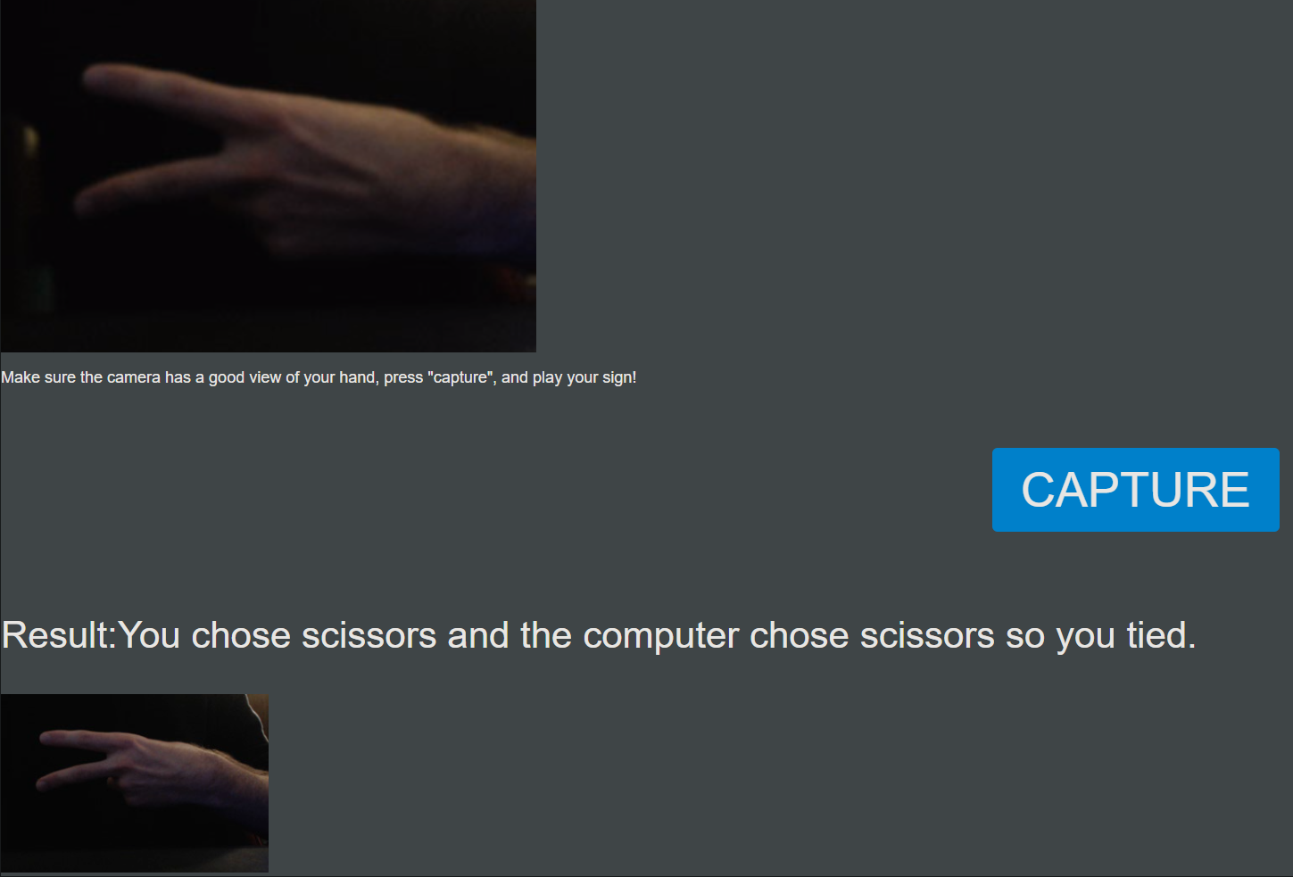
Methods (Deployment)
Python Flask backend used to deploy trained model to a server
Hosted using Gunicorn WSGI HTTP server and NGINX
Live and playable on rps.CodeSmith.link

Slide 7
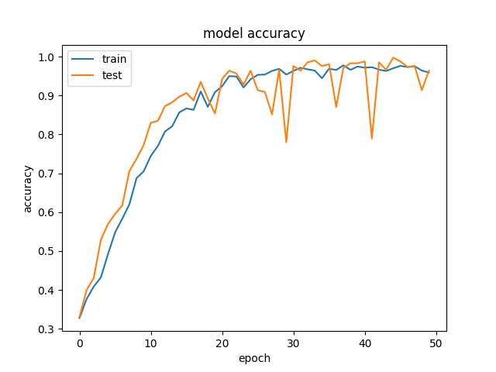
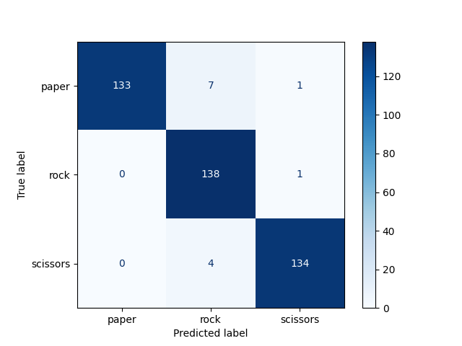
Results
Model achieved a final accuracy of 97% on training data and 98% on held out validation data after 50 epochs
Creating a confusion matrix allows viewing of validation data misclassification, showing very high accuracy and few errors
Anecdotally, model is very accurate if entire hand is in full view

Slide 8

Discussion/Findings
Using MediaPipe for feature extraction greatly improves reliability of the system
Allows model to focus more on classification based on shape of the hand than distinguishing the hand
Greatly reduces prior issues with background contrast/busy images

